Slide 1

DeepBasis: Hand-Held
Single-Image SVBRDF Capture
via Two-Level Basis Material Model
Li Wang, Lianghao Zhang, Fangzhou Gao, Jiawan Zhang.
Tianjin University
Notes:
Ok, Thanks for the introduction, I’m Li Wang from Tianjin University. Today, we pre‘sent our work DeepBasis: Hand-Held Single-image SVBRDF Capture via Two-Level Basis Material Model.

Slide 2
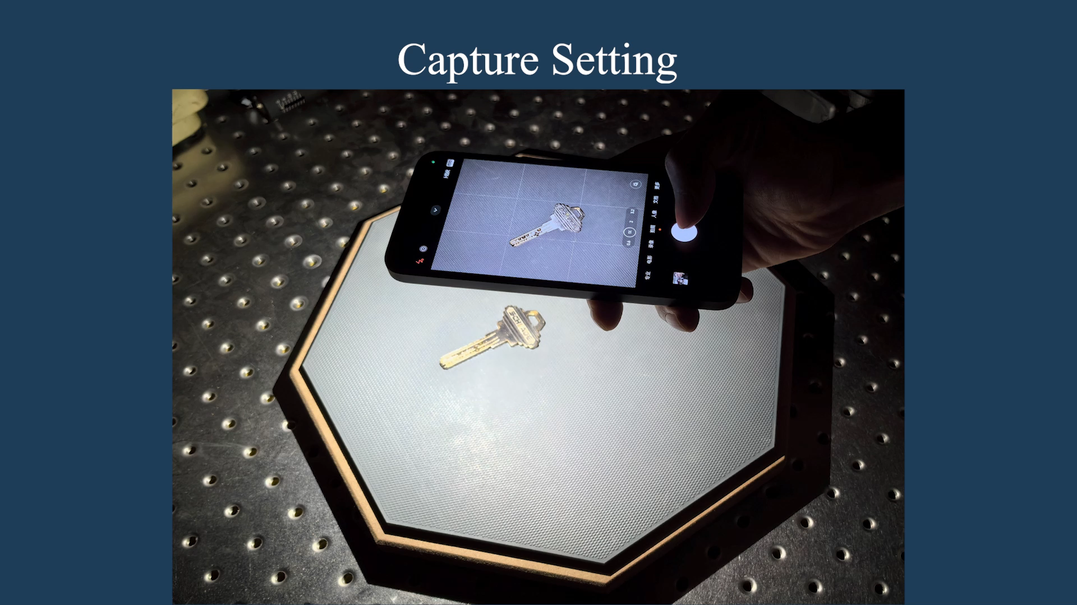
INTRODUCTION
Notes:
The convenient capture of real-world material reflectance can effectively meet the requirement of high-realistic rendering.
(click) Under the hand-held capture of a mobile device, we proposed a novel method to improve the quality of appearance modeling.

Slide 3
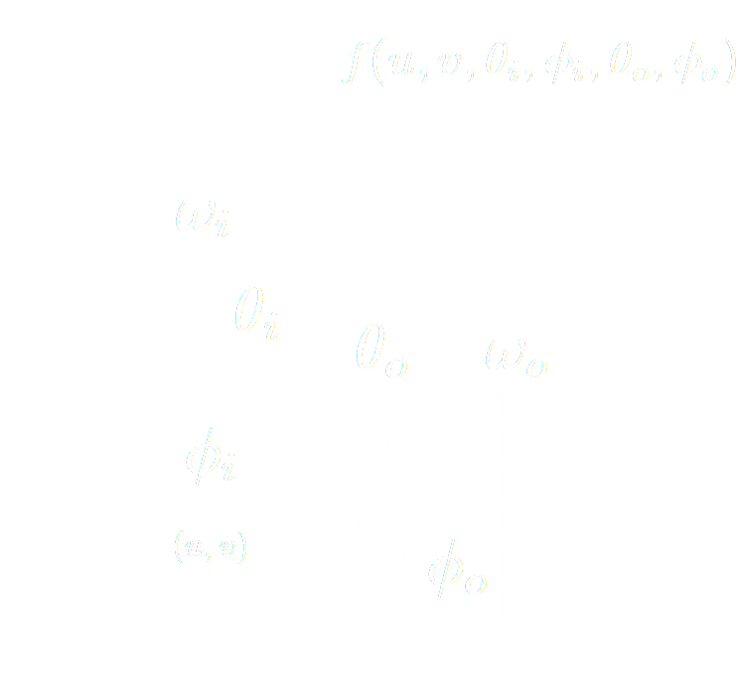


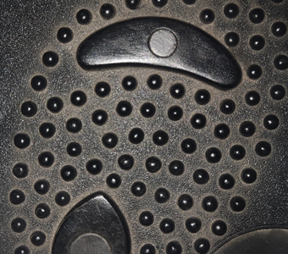
INTRODUCTION
Material Reflectance Modeling :
Viewing
Lighting
A tedious process to capture all measurements ! !
Notes:
The material reflectance is (click) usually modeled as SVBRDF. It is a high-dimension function to express all reflectance (click) defined on two hemispheres of lighting and viewing.
(click) Obviously, it is a tedious process to capture all!

Slide 4
INTRODUCTION
Single Image
Capture SVBRDF from a
For each BRDF
Only one measurement
Extremely ill-posed!
Need Priors !
Notes:
The most convenient method is to capture SVBRDF from a single image. （click）
However, it means there is only one measurement for each BRDF. It is an extremely ill-posed problem.
(click) We need Priors to constrain it.

Slide 5
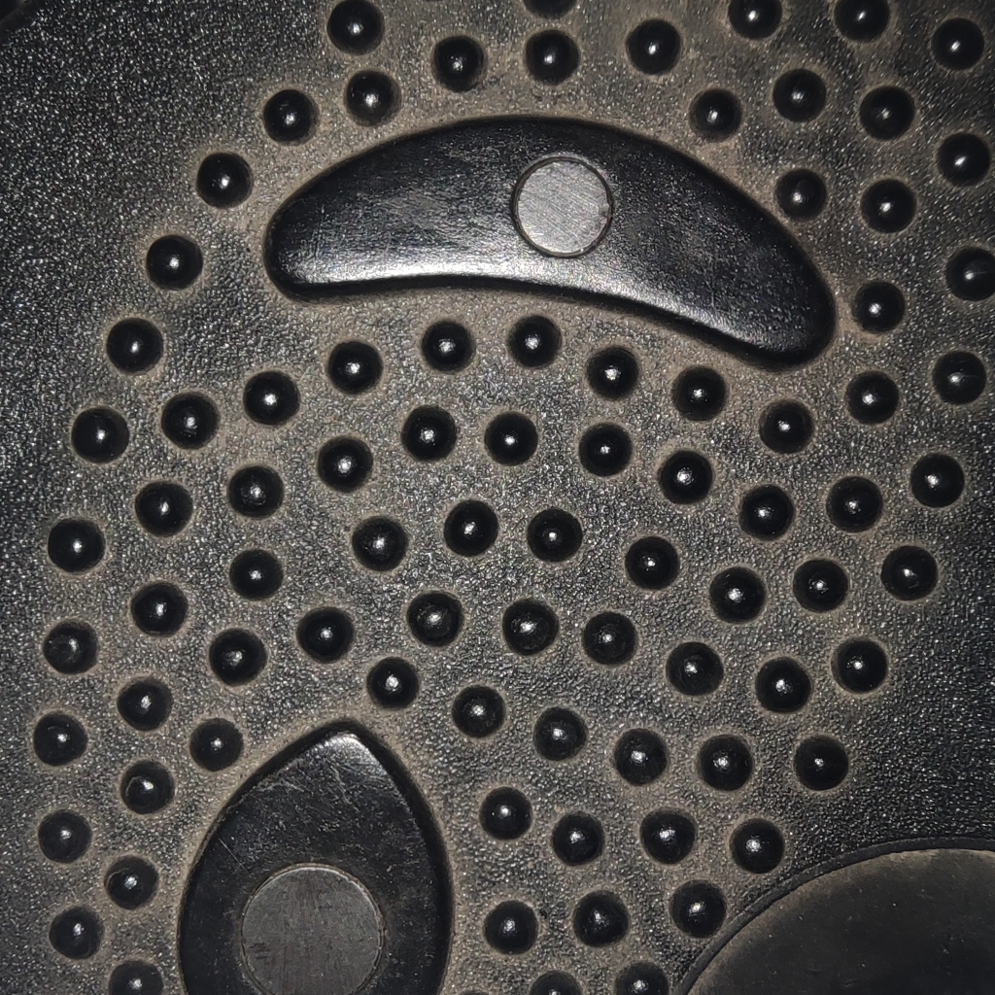
INTRODUCTION
An Important Prior --- Material Correlation
Independently model
Exist correlated reflectance features
Notes:
And one prior is Material correlations.
Although we independently model the reflectance for each surface point, among the real-world materials, there always exists correlated reflectance features between different points.

Slide 6
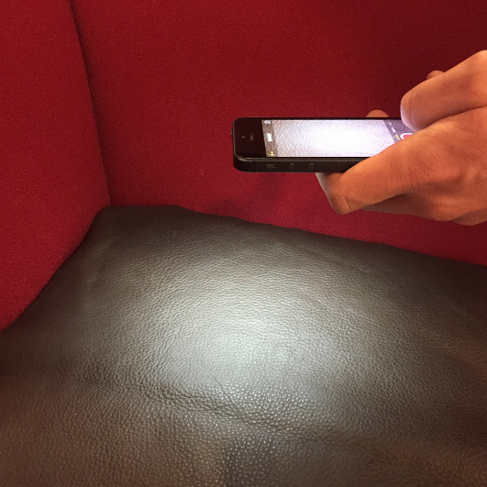
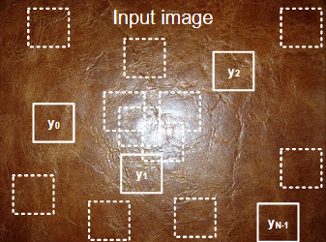
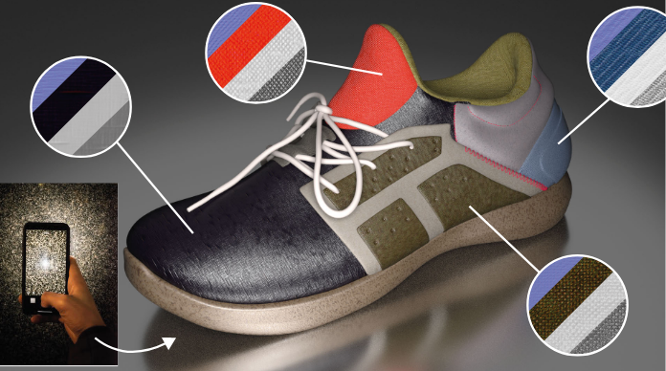
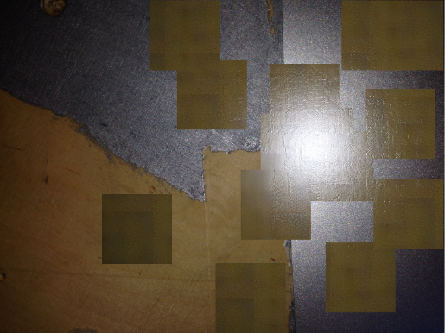
RELATED WORK
Texture-like assumption
[Aittala et al. 2015]
[Aittala et al. 2016]
[Henzler et al. 2021]
Do not satisfy the assumption
The applied range of these methods is limited!
Notes:
In previous work，the Texture-like assumption, as one of correlation has been explored in SVBRDF estimation. It simply assumes the material reflectance is self-similarity. However, in real world, so many cases do not satisfy this assumption, which means the applied range of these methods is limited.

Slide 7
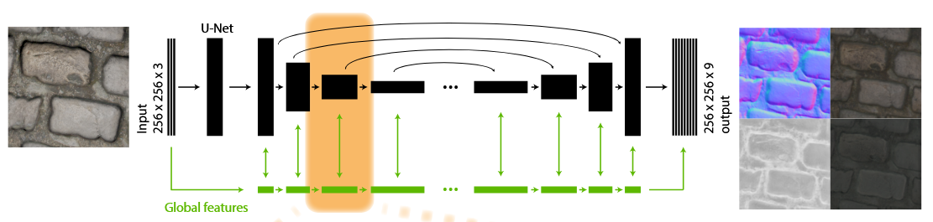
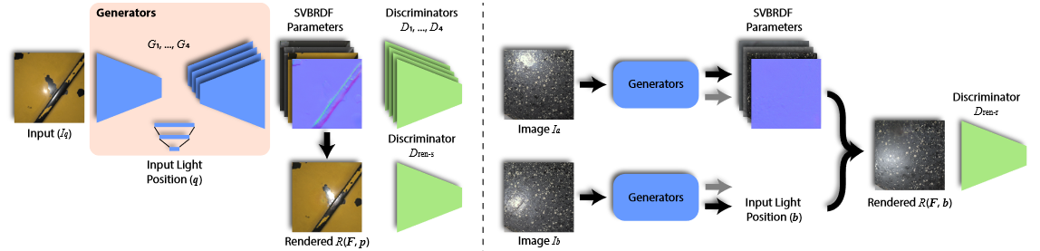
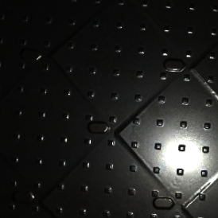
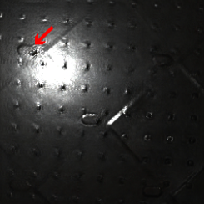
RELATED WORK
Rely on data prior
Implicitly utilize material correlation
（inefficient）
[Deschaintre et al. 2018]
[Zhou et al. 2021]
Input
Novel Rendering
Notes:
With the development of deeplearning, the data priors have been also explored to perform the SVBRDF estimation. It is equal to implicitly utilize the material correlations.
However, this is inefficient and can not recover the fine details.

Slide 8
METHOD
Key Idea
In the context of deeplearning based material estimation, build an explicit constraint to further release the potential ability of data prior
Notes:
Ok, Next it is our method.
in the context of deeplearning based material estimation, our key Idea is
building an explicit constraint to further release the potential ability of data prior.

Slide 9

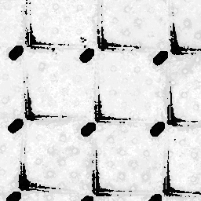
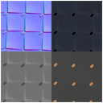



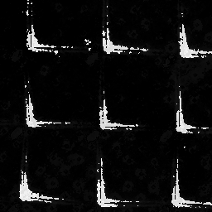
METHOD
Basis Material Model
Linear
Combination
General and flexible
Widely used in multi-image material estimation
SVBRDF
…
Basis BRDFs
Weights
Notes:
We adopt a more general and flexible assumption about material correlation, called Basis material model. It assume that SVBRDF is the linear combination of basis BRDFs and their corresponding weights.
And this assumption has been widely used in multi-image material estimation

Slide 10
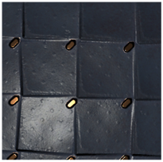
METHOD
How to introduce basis material model into Deep Learning ?
-- Straightforward Idea
Basis Material:
Rely on the variable basis number to adapt to diverse material
DeepLearning:
Fixed form to learn data distribution
Network
Prediction
Input Image
Conflicted !
…
Basis BRDFs
Weights
Notes:
However, it is not clear how to introduce basis material into deep learning.
A straightforward idea is to predict both basis BRDFs and weights from a single image.
Unfortunately, Basis material relies on the variable basis number to adapt to diverse material.
But deeplearning needs a fixed form to learn data distribution.
These two are conflicted.

Slide 11
METHOD
Two-Level Basis Material Model
-- Ensure the diversity in a fixed form
Step 1: Per-pixel variation replace number variation
Step 2: Use the global basis to keep the explicit material correlation
Notes:
To solve this problem, we proposed two-level basis material model to ensure the diversity in a fixed form.
It is a two-step thought.
In step 1, we use the per-pixel variation to replace the basis number variation, therefore it ensures a fixed form and leaves the diversity to the pixel variation that is well-suited for network prediction.
And next, we model per-pixel bases as the plus of global basis and local variation.
The global one is uniform for each surface points and we can use them to keep the explicit material correlation.

Slide 12
METHOD
Prepare data for training
Not Exist
Hardly Generate
Input Image
Local Basis
,
Global Basis
…
…
Notes:
After designing the material model, we need to prepare data for training.
Under the ideal conditions, we hope to have a sufficient amount of corresponding data for training like this.
(click) However, in the real world, this dataset does not exist and is hardly to generate.

Slide 13
METHOD
Joint training
Two-level Basis Materials
Ambiguity
Joint Prediction
Input Image
SVBRDF
Weights
Existing SVBRDF Dataset
[Deschaintre et al.]
Notes:
Therefore, to perform training without ideal data, we adopt a joint prediction of basis materials and weights.
In this way, we can get the predicted SVBRDF at each iteration of training, so the existing SVBRDF dataset can be used.
(click) However，the lack of direct supervision on basis or weight can result in the ambiguity.

Slide 14



METHOD
Variation-Consistency Loss
Add Radom and Uniform $ξ$ for the new input genration
Twice network forward pass
1st SVBRDF
1st Input Image
1st Basis Materials
1st Weights
$$ξ$$
$$ξ$$
Network
2nd SVBRDF
2nd Input Image
2nd Basis Materials
2nd Weights
Variation
Consistency
Notes:
To constrain the ambiguity, we designed a variation-consistency loss. And this loss leverages the variation between twice network forward passes for the supervision of basis materials.
(click) Through the first pass, we can get one predicted basis and weights.
(click) And we manually add a random and uniform variation kexi into the first SVBRDF for the new input generation.
(click) Then through the second pass, we get another one basis and weight.
(click) and this loss ensures the variation on the predicted basis materials is consistent with the added kexi.

Slide 15
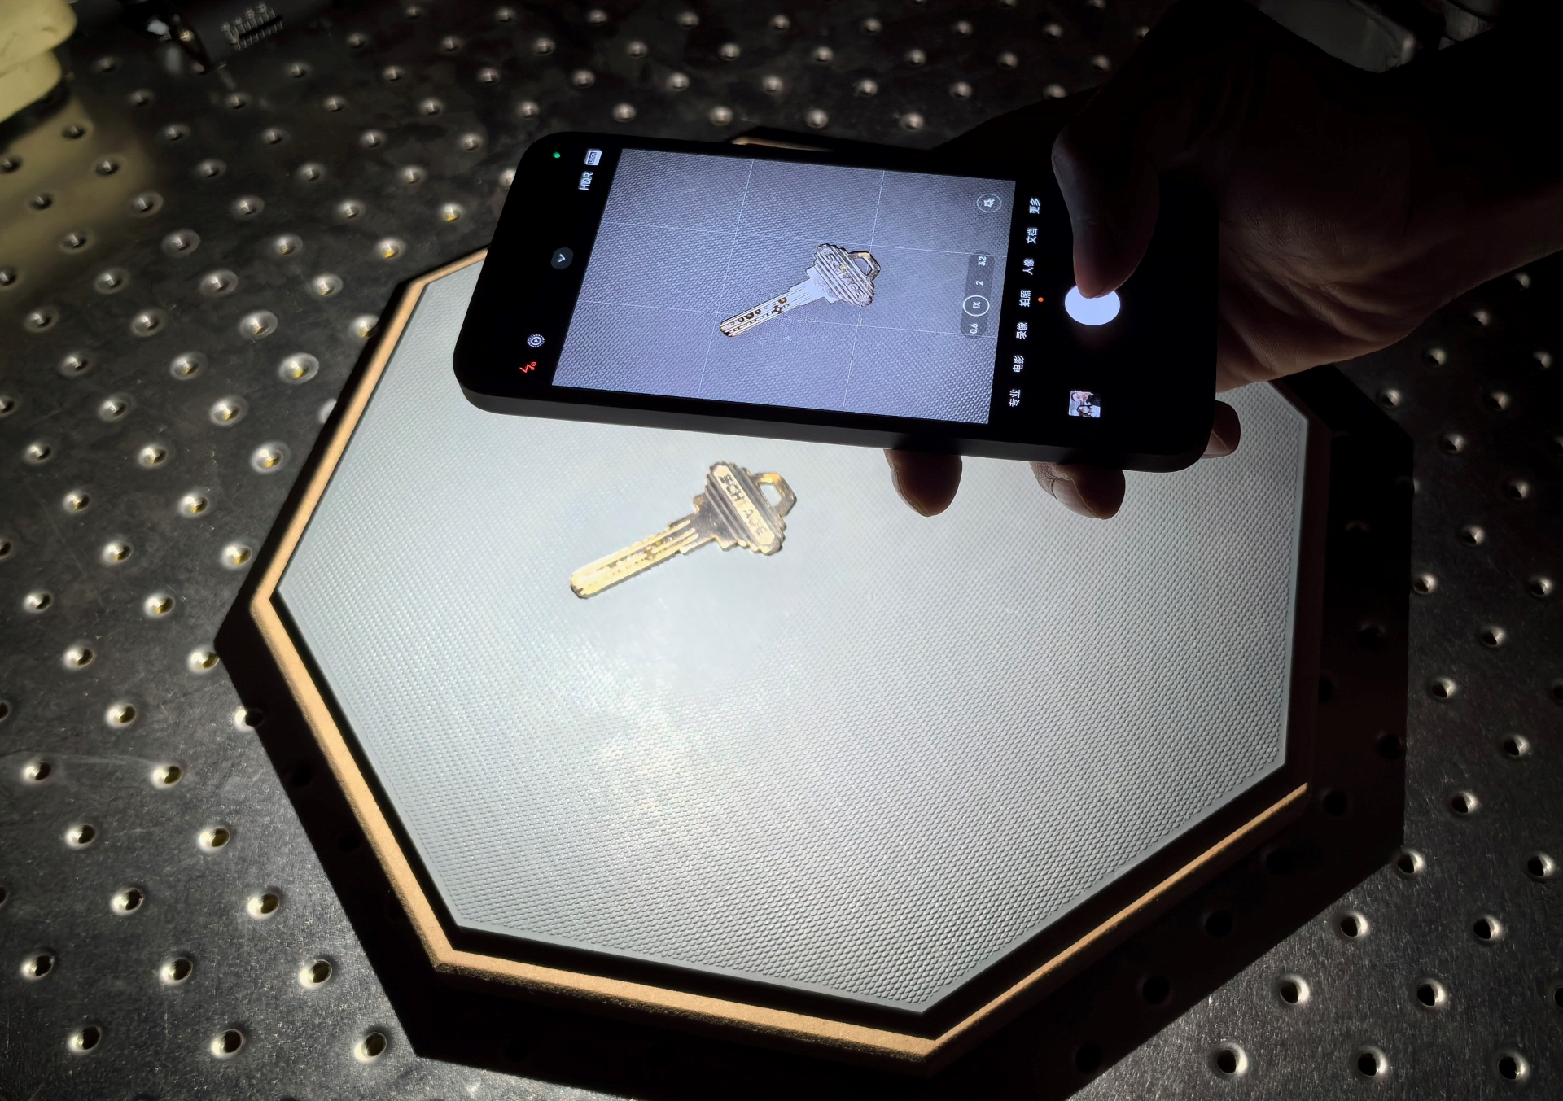
METHOD
Real Capture --- Mobile Setting
Hand-held Capture can’t ensure a strict parallel
The error shouldn’t be ignored for high-quality capture
Single Flash Image Capture
Notes:
For the real capture, we follow the mobile setting.
But, the Hand-held Capture can not ensure a strict parallel to the material surface
And we think the error should not be ignored for high-quality capture.

Slide 16
METHOD
Estimate Lighting Directions
Key Observation:
For the user, limiting the degree of offset is a natural and easy action
Notes:
To solve this problem, we proposed a method to estimate lighting directions.
The key observation is that for the user, limiting the degree of offset is a natural and easy action.
(click) Just look at this, if there is a significant offset, we can easily recognize it.
(click) So, in the ideal capture, we add an offset to the known FOV. (click) In this way, we can get a full directions set corresponding to the probable capture area.
(click) And in the real capture, the lighting directions must be a sampling from this set.

Slide 17
METHOD
Direction Estimation Based on a Sampling Set
Sampling
Network
Lighting Directions
Estimated SBRDF
Lighting Direction Set
Reconstruction Loss
Input Image
Rendering Image
Notes:
In this way, during the test phase, we can iteratively sample the lighting direction to get the optimal one which has the lowest reconstruction loss.

Slide 18
METHOD
Pipeline Summary
Notes:
Ok, here is a pipeline summary.
We use a single image as the input, and jointly predict two-level basis materials and weights. And we use the variation-consistency loss to ensure the correct supervision.
During the testing phase, we designed a sampling-based method to estimate the real lighting directions.

Slide 19
RESULTS
Results
Notes:
Next, lets see some results.

Slide 20
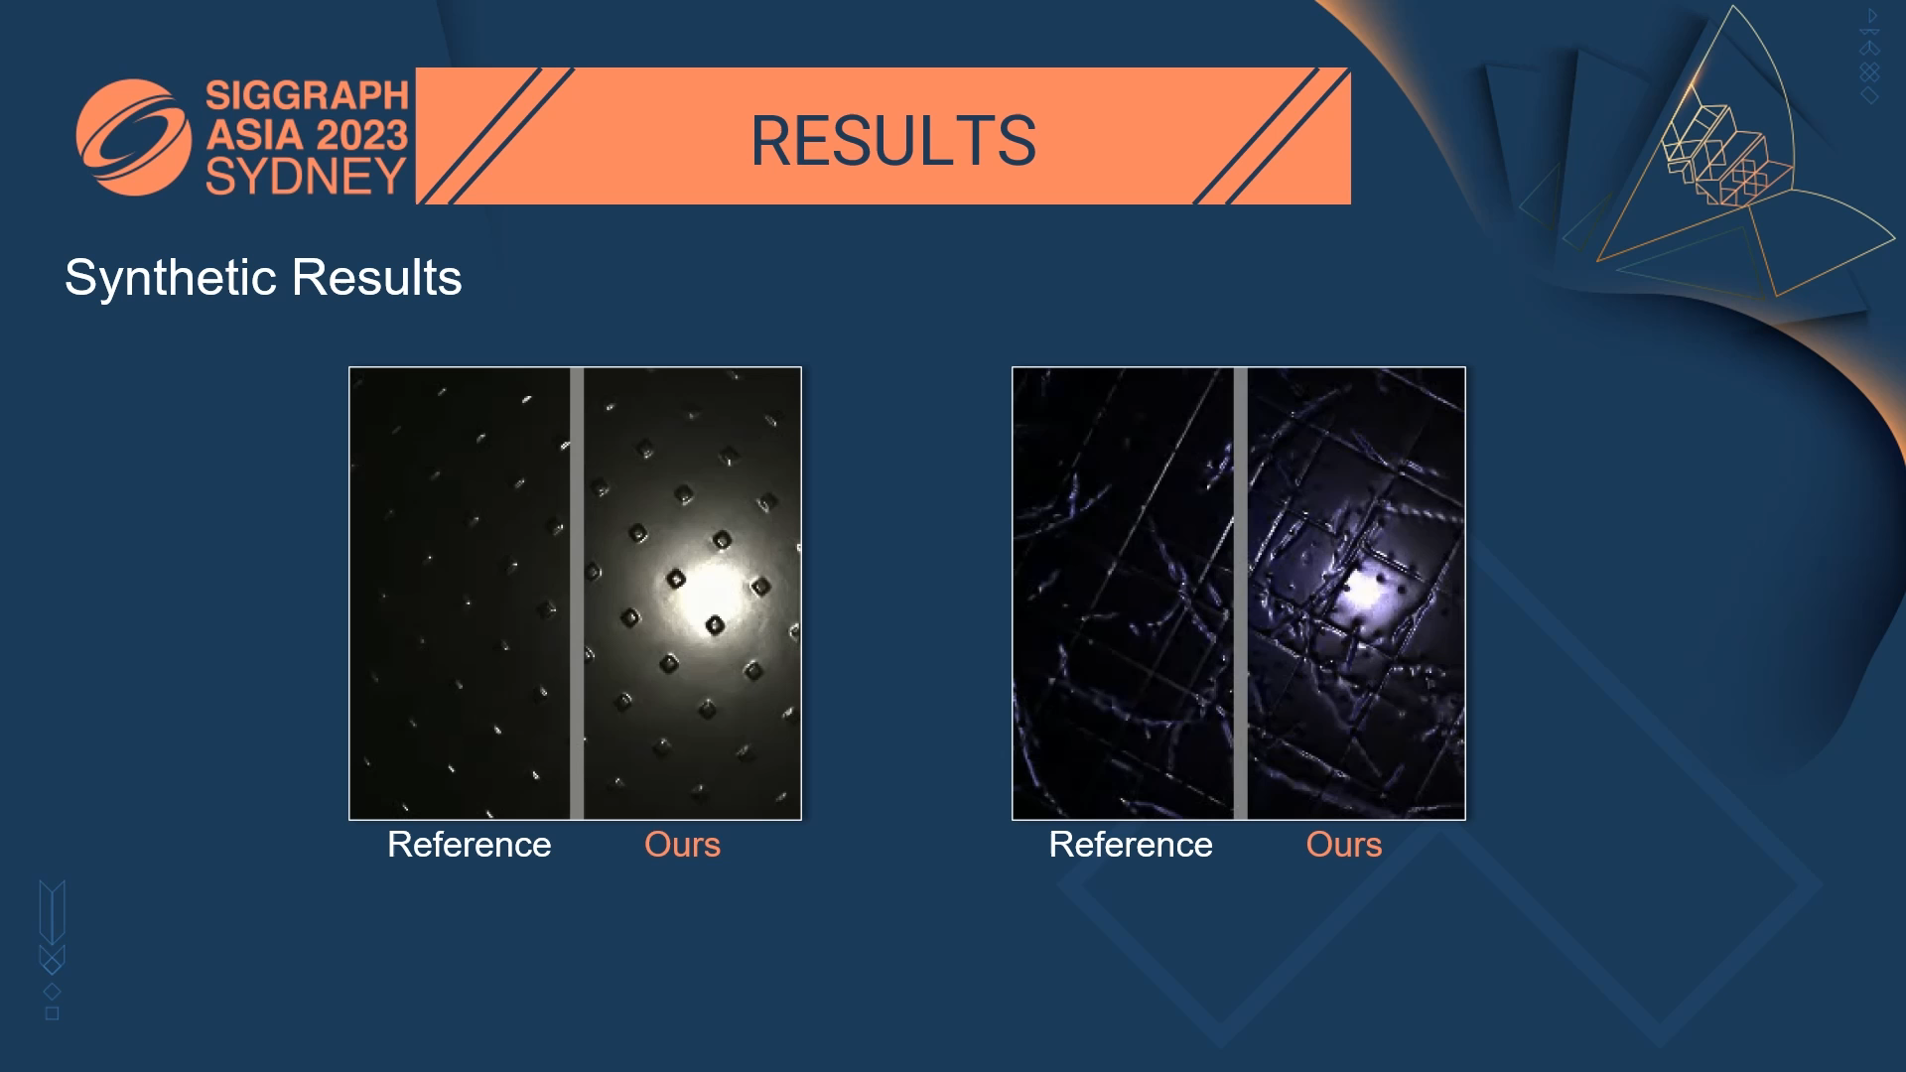
RESULTS
Synthetic Results
Notes:
First are synthetic Results. Here we show two high-specular samples that are extremely challenging to single-image method.
But we can see our method can also get a high-quality result.

Slide 21
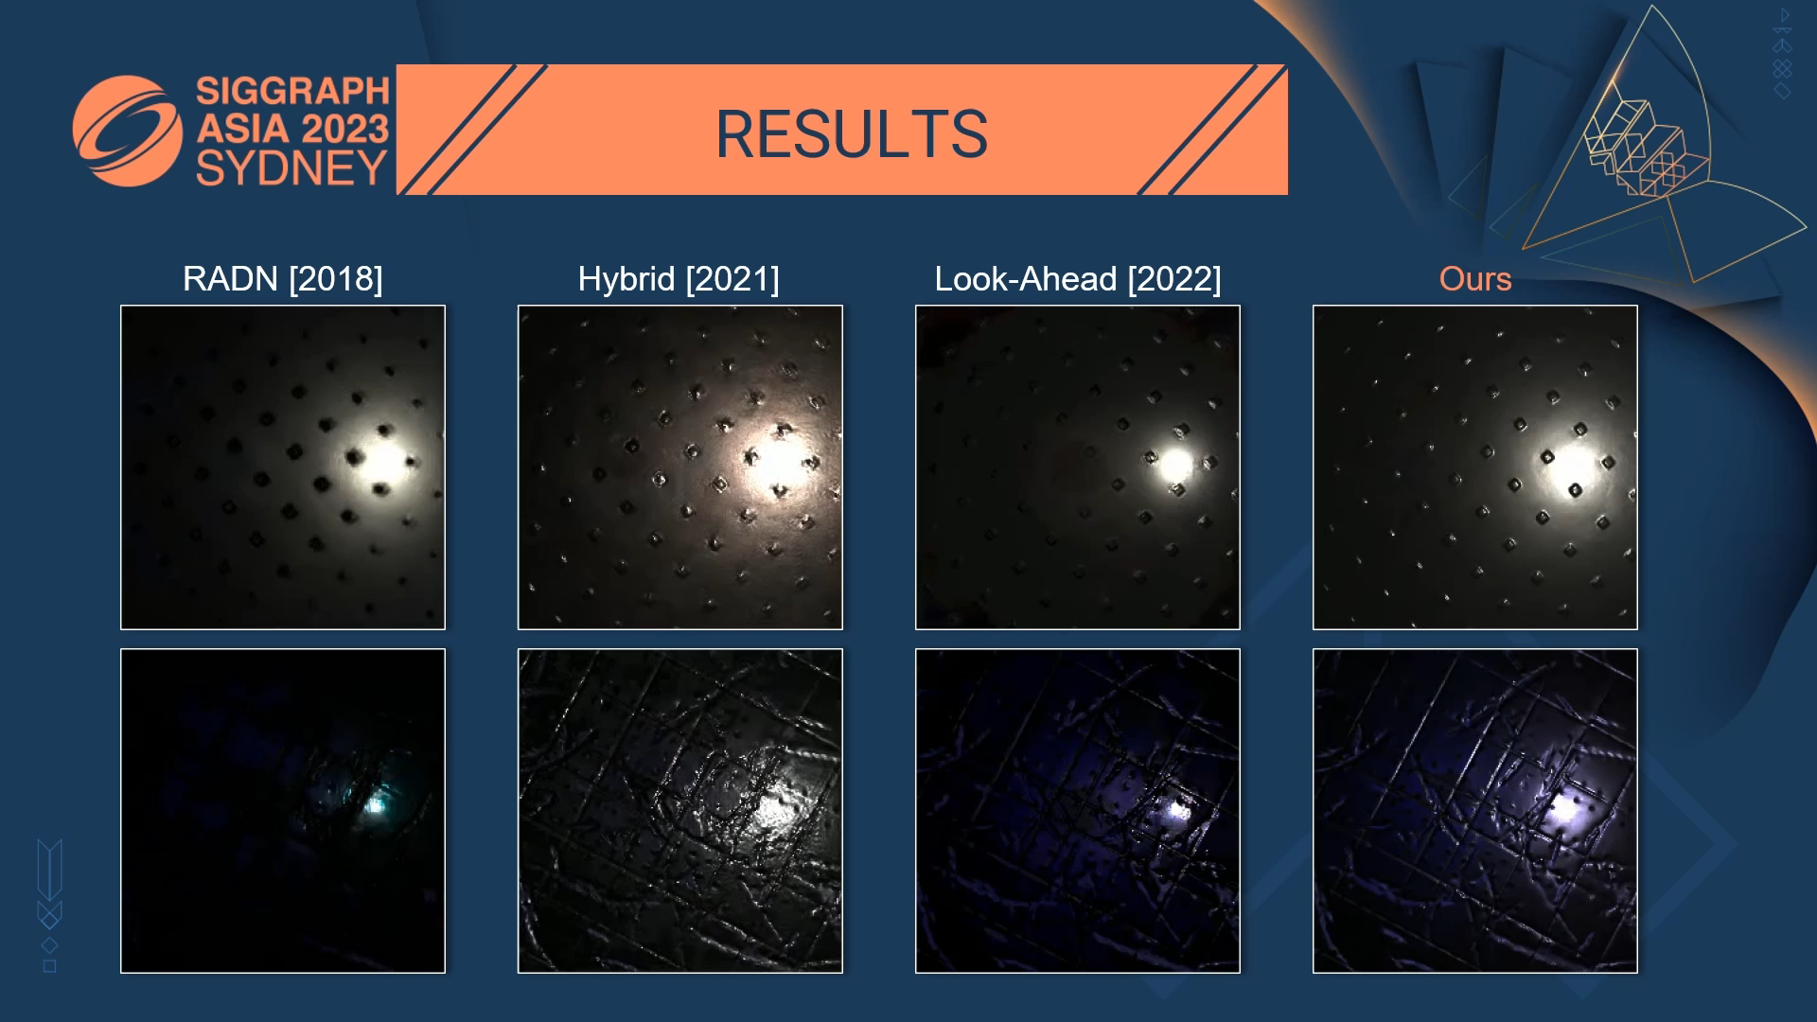
RESULTS
RADN [2018]
Hybrid [2021]
Look-Ahead [2022]
Ours
Notes:
Compared to the previous work, our method can significantly reduce the artifacts and preserve the fine `detail.

Slide 22
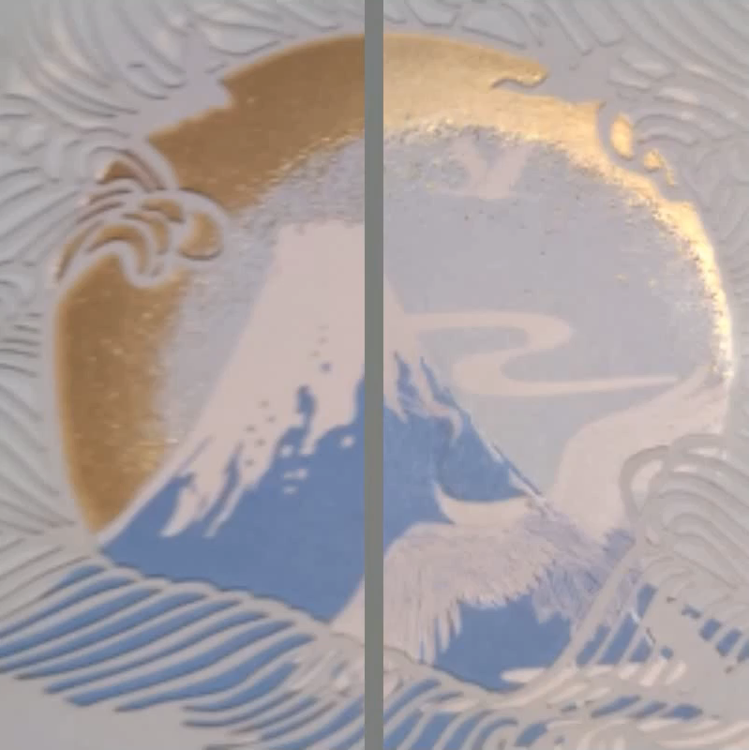
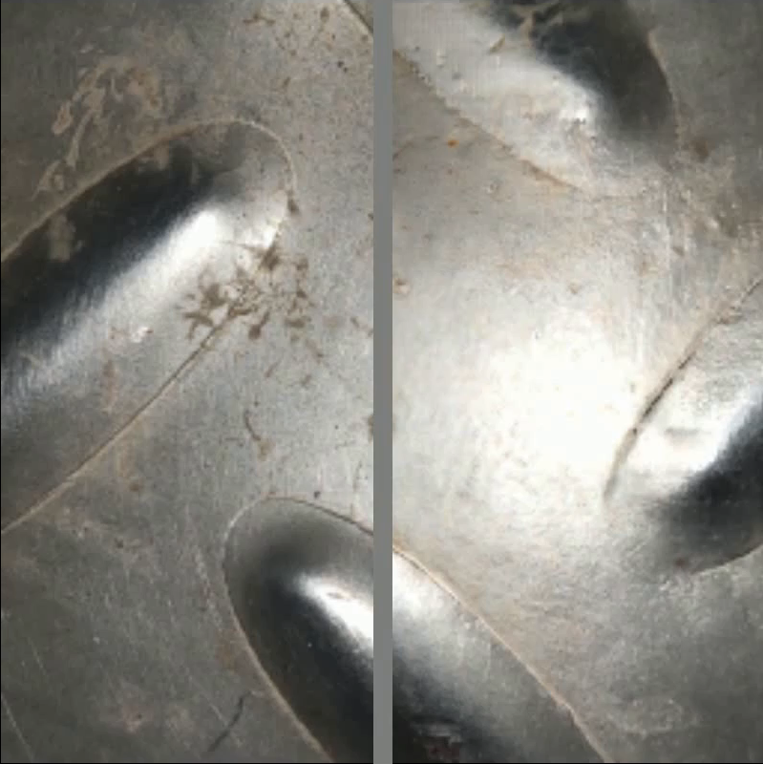
RESULTS
Real-World Results --- 9 corresponding reference images
Reference
Reference
Ours
Ours
Reference
Reference
Ours
Ours
Notes:
Next are Real results.
Here, for a convenient comparison, we provide 9 corresponding reference images for each sample.
We can see no matter the overall or the details, our reconstructed results are close to the reference.

Slide 23
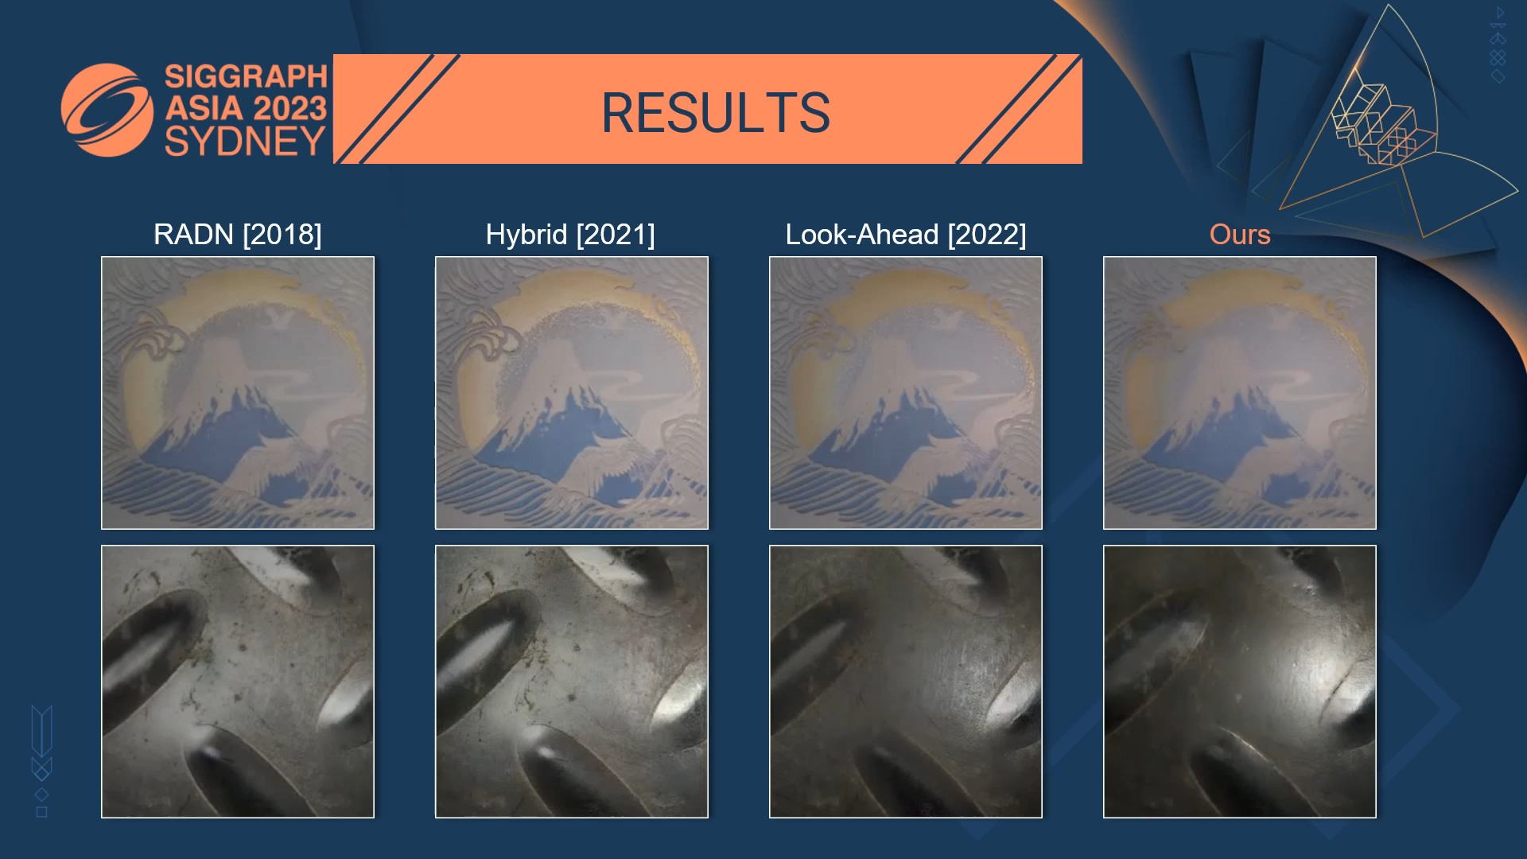
Notes:
And compared to the previous work, our results have much better highlight details. So it looks like more realistic.

Slide 24
LIMITATION
SVBRDF
Re-rendering
Input
[Deschaintre
2018]
[Zhou 2021]
The learned distribution is not always accurate
Fail to recover the surface printed with 3D patterns
[Zhou 2022]
ours
Notes:
Of course, we also find some limitations.
Although we introduce the basis material model to constrain data priors, the learned distribution is not always accurate.
Such as, our methods fail to recover the material surface printed with 3D patterns.

Slide 25
CONCLUSION
Explore how to Integrate explicit Basis Material Model into the learned material data priors.
Technical Contribution:
Two-level basis material model
Variation-consistency Loss
Sampling-based lighting direction estimation.
https://cgliwang.github.io/DeepBasis/
Notes:
Ok, In summary,
Our work explores how to integrate an explicit basis material model into the learned material data priors.
Technically, we proposed a two-level basis material model, designed a variation-consistency loss, and provides a sampling-based lighting direction estimation.
And you can scan this QR code for more details.

Slide 26
ACKNOWLEDGEMENTS
Anonymous Reviewers
SVBRDF dataset [Deschaintre et al. 2018]
Funding Agency
National Key Research and Development Program of China (2022YFF0904301)
Notes:
Finally, Thanks to the reviewers, open-source dataset, and the funding agency.

Slide 27
THANKS
https://cgliwang.github.io/DeepBasis/
Notes:
If you have any questions, we can discuss them after this session. Thanks for listening.

